Slide 1
Punishment and Deterrence: Evidence from Drunk Driving
By Benjamin Hansen
Discussion by Jeff Denning

Slide 2
What is the author’s question?
Does punishment affect the probability of recidivism (reoffense)?
Specifically, if a driver gets a DUI, are the less likely to reoffend in the future?
If so, why? Incapacitation, Deterrence, Rehabilitation

Slide 3
Why is this interesting?
Crime has huge social costs and we are interested in what policies work to reduce crime
Harsher punishments may work to deter crime but it’s hard to know the causal effect of punishment on future crime
Why? Punishment is not randomly assigned and so harsher punishments are usually correlated with criminals committing bigger crimes

Slide 4
Data
Data from Washington state 1999-2007 on all DUI BAC tests.
Has BAC measures (2)
Has information on the driver, officer, incident
Also uses court records on types of punishment and other crimes

Slide 5
Method
Pretty straightforward RD.
The running variable is BAC, and the thresholds are .08 and .15 for DUI and aggravated DUI.
Treats as a sharp RD because that’s how the law is written

Slide 6
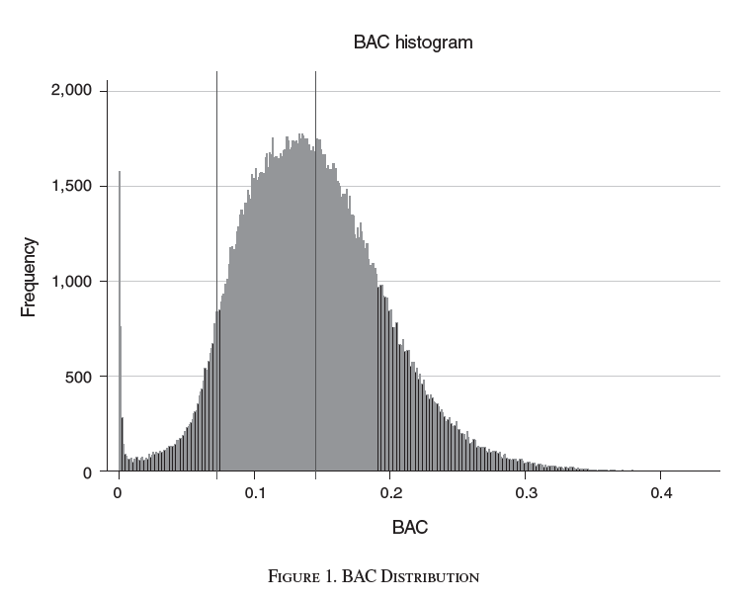
Assumption Checks: Bunching at Threshold?

Slide 7
Formal Tests
McCrary P values at .08 of .59, at .15 of .38
Frandsen .795 for .08 and .886 for .15

Slide 8
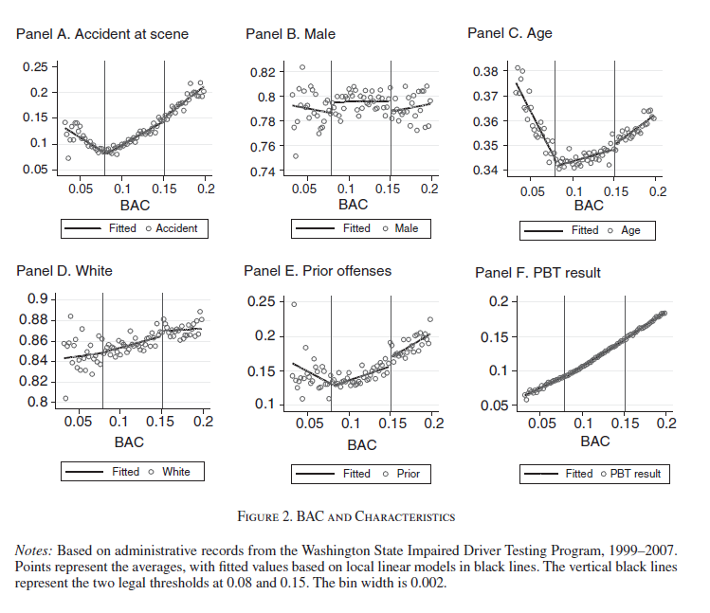
Assumption Checks: Continuity of Covariates

Slide 9
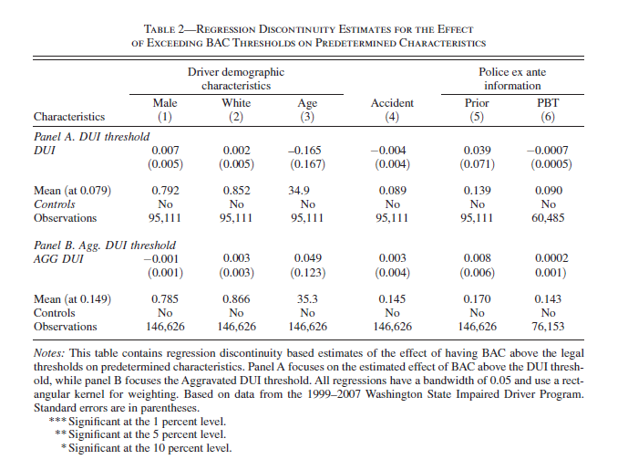
Covariates Tests

Slide 10
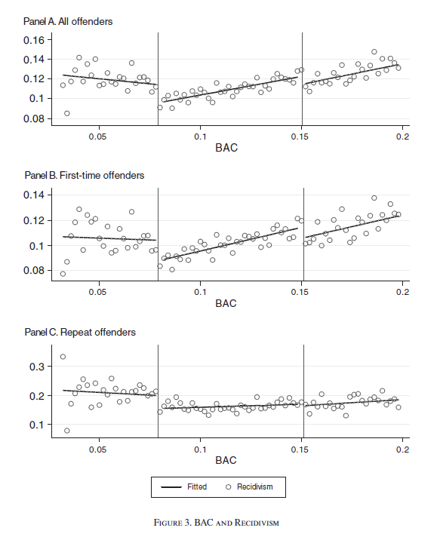
Results: Figures

Slide 11
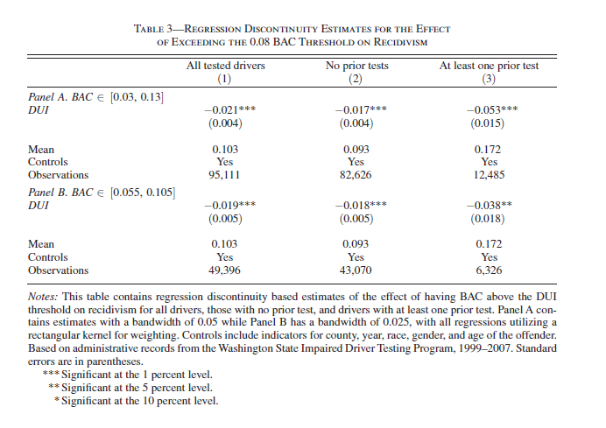
Results: Table

Slide 12
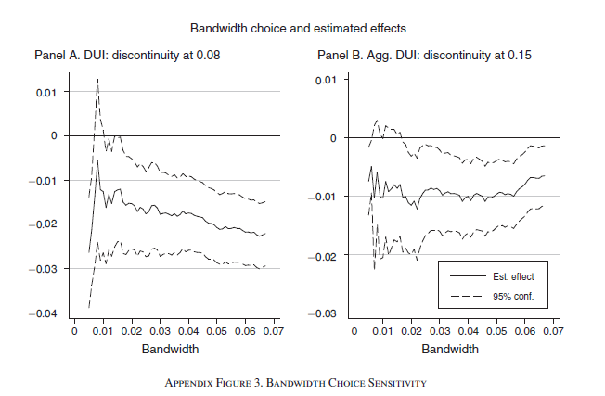
Robustness

Slide 13
Why?
This could reduce crime for 3 reasons:
Incapacitation--the driver cannot drive due to not having a license/being in jail/etc
Rehabilitation--the driver does not drink any more or re-evaluates the costs of drunk driving
Deterrence--the driver does not want to be punished again.

Slide 14
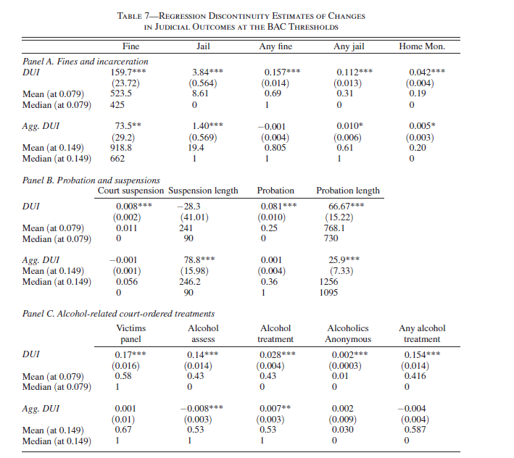
Judge Actions Change

Slide 15
Why can’t he separate the effects of Judge Actions?
Many things change at the threshold: fine, jail, home monitoring, suspension, probation, alcohol treatment, etc.
Can he just regress recidivism on these things to get the causal effect of alcohol treatment?
These outcomes are not randomly assigned so we can’t get the causal effect. DUI is quasi-randomly assigned but alcohol treatment is not

Slide 16
Incapacitation
He looks at recidivating in varying time windows
Much of the change in recidivism is after the end of loss of driving privileges--hence not likely driven by incapacitation

Slide 17
Rehabilitation
At .15 threshold, court-ordered treatments do not change. Hence, if effect was driven by rehabilitation you would not expect effects at .15--but there are
Also, other crimes that are often influenced by alcohol are not affected.

Slide 18
Deterrence
Future punishment increases at both thresholds.
The reduction in recidivism is consistent with this.

